Slide 1


The COVID-19 pandemic as a driver towards integrated health care - learning from the experiences of UK Community Hospitals
Presentation to ICIC23 Antwerp May 2022
Dr David Seamark
Vice President Community Hospitals Association
david.seamark@nhs.net
Email – infocommunityhospitals@gmail.com
CHA Website – www.communityhospitals.org.uk

Slide 2

Community Hospitals Association
52 Years of the CHA in 2022
Members in UK & Internationally
500 Community Hospitals in the UK
117 Providers of Community Hospitals in the UK
CHA has 20 Committee Members
145 CHA Awards for Innovation and Best Practice in 20 years

Slide 3

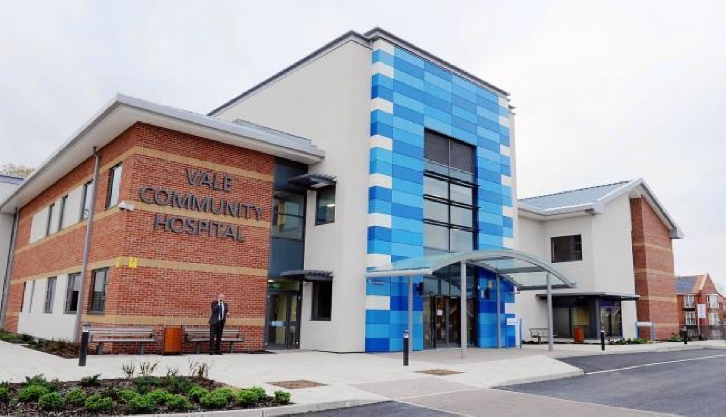
A community hospital is:
Small local hospital
Led by community based staff
Typically rural
Serving a local community
The Vale Hospital, Gloucestershire, England

Slide 4

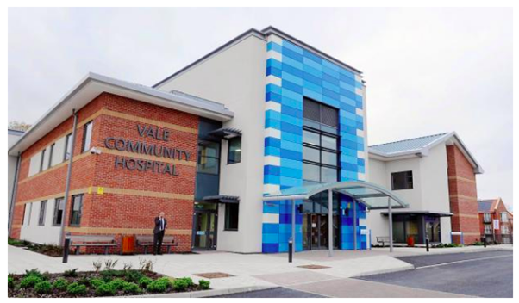





CHA Awards
CHA Award to Matrons Oxfordshire
Community Hospitals
CHA Award to the Team at Robinson Memorial Hospital, Northern Ireland
CHA Award to theTeam at Launceston
Community Hospital, Cornwall

Slide 5


Community Hospitals Contribution During COVID-19
http://www.communityhospitals.org.uk/quality-improvement/reports.html
This project was funded by the Health Foundation and NHS England & Improvement
The project was undertaken by the Community Hospitals Association in the UK

Slide 6



85 staff interviewed using Appreciative Inquiry
20 Organisations managing 168 community hospitals in the UK
30 case studies selected and developed

Slide 7




Sharing the Learning from Innovations
Recognising Improvements in Quality
Sharing Best Practice in Integrating Care
Building an International Network

Slide 8
Staff Said Community Hospitals are:
Integrated
Resilient
Flexible
Responsive
Creative
Compassionate

Slide 9
A Focus on Integrated Care
An Analytical Framework for Factors Influencing Integrated Care
Organisational Culture
Workforce Management
Inter-organisational Collaboration
Leadership Ability of Staff
Economic factors
Political factors
Bhat K, Easwarathasan R, Jacob M, et. al. Identifying and understanding the factors that influence the functioning of integrated healthcare systems in the NHS: a systematic literature review BMJ Open 2022;12:e049296. doi: 10.1136/bmjopen-2021-049296

Slide 10
4 Types of Integrated Care Featured
Multi-Disciplinary Team Working
Community Hospital and Primary Care
Community Hospital and Acute Care
Community Hospital and Local Community

Slide 11
Case Studies
Multi-Disciplinary Team Working
Enhancing the care offered during COVID-19, requiring enlarged teams with additional training to work together
Creating local training videos at speed at the start of the pandemic for teams including redeployed staff
Offering daily huddles for team leaders of all departments and disciplines, to coordinate support and management during the pandemic

Slide 12
Case Studies
Community Hospital and Primary Care
Early interventions across the GP practice and community hospital at the start of the to protect patients and staff
Primary care support to community hospital increased during COVID-19

Slide 13
Case Studies
Community Hospital and Acute Care
Working with Secondary Care Services to change the use of inpatient beds during COVID-19
Collaborating with Managers in Acute to relocate specialist cancer care services during COVID-19
Creating a 7 day service with improved working systems across acute and community

Slide 14
Case Studies
Community Hospital and Local Community
Improved communications and more shared working between staff, patients and families during COVID-19
Local community support to the community hospital such as volunteering, donations, playing bagpipes by the ward etc.
Working together to provide compassionate care for patients at the end of life, within the COVID-19 restrictions

Slide 15
Analysis of 11 Case Studies
Factors Influencing Integrated Care – ranked
Leadership ability of staff
Organisational Culture
Inter-organisational collaboration
Workforce Management
Economic
Political

Slide 16
Types of Integrated Care
Type | Description
Horizontal | Multi-disciplinary Teams Community hospitals, primary care and community services
Vertical | Community hospitals and acute secondary care hospitals

Slide 17
Levels of Integration
Micro - a community hospital service
Meso – across community hospital(s)
Macro – across the Organisation or health system

Slide 18
Conclusions
The pandemic accelerated integrated care between staff, services and systems
The pandemic improved recognition of the vital role of community hospitals as community services in the local health and care system
Locally devolved decision making appropriate to the local context is seen as a critical factor in the swift implementation of improvements.
Workforce management, collaboration between organisations and organisational culture influenced by strong leadership were crucial factors in driving integration multiple levels or organisation

Slide 19





CHA Q Project Team
Dr David Seamark
Dr Helen Tucker
Evelyn Prodger
Trish Jay
Dr Emma Gibbard
This project was funded by the Health Foundation and NHS England & Improvement
The project was undertaken by the Community Hospitals Association in the UK

Slide 20
Email: infocommunityhospitals@gmail.com
Website: www.communityhospitals.org.uk
Free Individual Lifetime Membership: http://www.communityhospitals.org.uk/membership-application.html
Twitter: @CommHospUK
Linkedin: Community Hospitals Association
Facebook: Community Hospitals Association

